Slide 1
Paper review: AniMOJity: Detecting Hate Comments in Indic languages and Analysing
Bias against Content Creators
Proceedings of the 19th International Conference on Natural Language Processing (ICON) |Published:2022
Team No: 06
Presented by-
Name: Md. Nazrul Islam
ID: 19301124
ST- Ehsanur Rahman Rhythm
RA- Adib Muhammad Amit

Slide 2
Introduction:
- focuses on the issue of harmful and biased internet content
- highlights a rise in racially, sexually, and religiously biased content
- presents a novel hate speech detection model called Animojity
- incorporates transfer learning and utilizes state-of-the-art pre-processing and post-processing techniques
- achieves an impressive test f1-Score of 88.6% on the Moj Multilingual Abusive Comment Identification dataset
- annotate 300 samples to investigate bias categories such as gender, clothing, age, religion, and race
- also address the issue of users switching between different languages while expressing their thoughts on social media
- Animojity addresses this challenge by detecting hate comments in thirteen regional languages, including Hindi, Urdu, Telugu, Marathi, Gujarati, Malayalam, Punjabi, Assamese, Kannada, Bengali, Tamil, Rajasthani, and Haryanvi.

Slide 3
Related work:
In this section three different type of paper are described
- Hate Speech Detection
1. Showcased 15,000 annotated Facebook posts and comments in English and Hindi as non-aggressive, covertly aggressive, and overly aggressive.
2. presented a 24,000 corpus for identifying English tweets belonging to profanity, hate speech, and non-offensive categories
- Multilingual Text Classification
1. studied MTC in Spanish, Italian, and English by using the Ngram technique and Naïve Bayes to predict the language of a document in classification
- Impact of Biased Attack on Social Media
1. Mostly attacks are against female content creators and are not just hateful but offensive

Slide 4
Dataset:
Methodology:
The dataset utilized in this study was made available by the Moj Multilingual Abusive Comment Identification Challenge organizers in partnership with IIIT-D.
Data Pre-processing:
- stop-words removed from the dataset
-substituted emojis from the tweet
-took NLTK library support for preprocessing Hindi.
-perform tokenization using XLM-R.
XLM-R Model and finetuning
Incorporating MLM with Fine Tuning
Model Design
Psuedo labelling
Text Classification

Slide 5
Experimental Setup:
Baseline Model used in this work is m-BERT
Because of Limitation of m-BERT the researcher explore the use of MuRIL, a model trained on Indian regional languages, to improve NLP tasks.
split into two pipelines: learning and testing. they employed mBERT and XLM-R
implemented using Python 3.10.0 with TensorFlow v2.6.1 as the deep learning framework.
created and trained using TensorFlow and Keras. The dataset is divided into a 90/10 ratio for training and evaluation purposes. Accuracy and F1 scores are used as evaluation criteria for comparing different models.

Slide 6
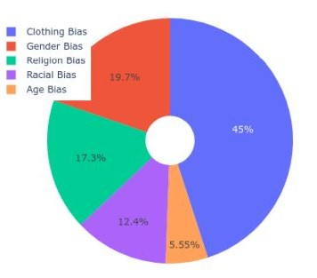
Results and Analysis:
Results:
CNN – BiLSTM (XLM-R) 96.324% accuracy & F1 score 87.181%
AniMOJity 95.604% accuracy & 88.602% F1 score
Analysis:
Clothing Bias
Gender Bias
Religion Bias
Racial Bias
Age Bias

Slide 7
Conclusion:
not to promote biased discourse
aim to educate the audience about the distorted perspectives
creating more reliable platforms for discussing creators on social media

